Slide 1

For Loops, Deconstructed
Notes:
[1:0]
welcome

Slide 2
Review
Notes:
[0:20; 1-2]

Slide 3
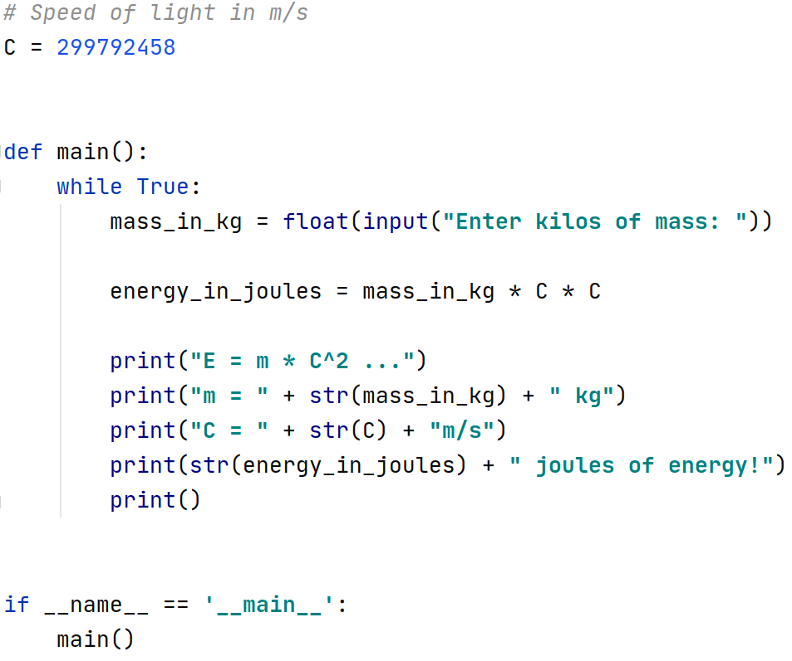
Notes:
[1:0; 2-3]
variable definition
snake case

Slide 4
Notes:
[0:30; 3-4]
assignment

Slide 5
Notes:
[0:30; 3-4]
binary operator

Slide 6
Notes:
[0:30; 4-5]
user input

Slide 7
Notes:
[1:30; 5-6]
types
typecast function

Slide 8
Notes:
[0:30; 6-7]
string concatenation

Slide 9
For Loops
Notes:
[0:30; 7-8]

Slide 10
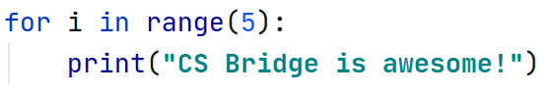
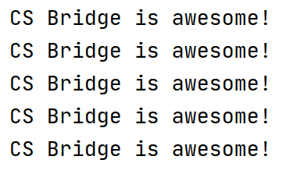
Notes:
[0:30; 8-9]
fixed number of repeats
for loop is much more powerful

Slide 11
Notes:
[0:30; 9-10]
variable
different name

Slide 12
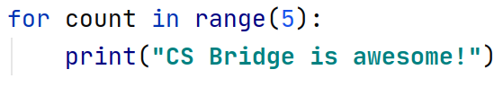
Notes:
[0:30; 10-11]
any variable name is ok. Let’s stick with i.
what is the value of the variable?

Slide 13
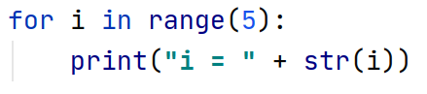
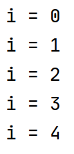
Notes:
[1:30; 11-12]
the 5 is not among the values
it starts from zero
ends before 5

Slide 14
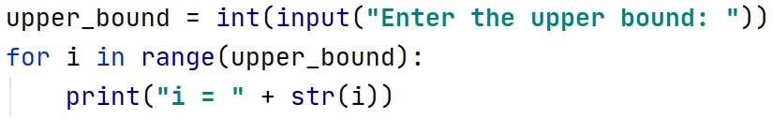
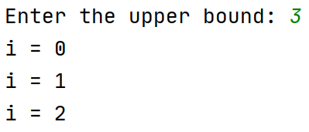
Notes:
[1:0; 12-13]
the range can also contain a variable
we can ask the user to enter the upper bound

Slide 15
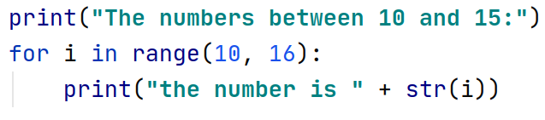
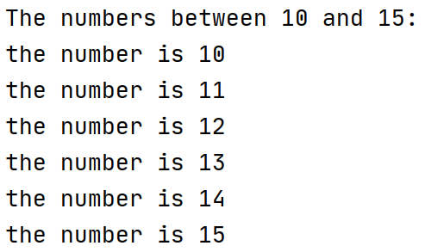
Notes:
[1:0; 13-14]
print the numbers between 10 and 15
we need to start from 10, not from 0
range: two arguments
comma
16 not 15

Slide 16
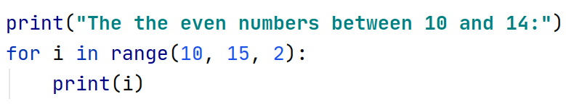
Notes:
[1:0; 14-15]
let’s trace it

Slide 17
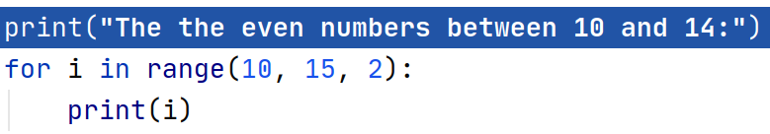
Notes:
[0:15; 15-16]

Slide 18
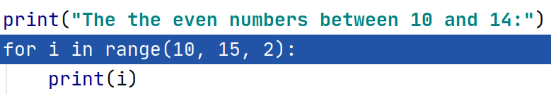
Notes:
[0:15; 15-16]

Slide 19
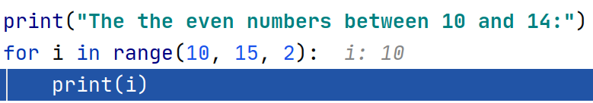
Notes:
[0:15; 15-16]

Slide 20
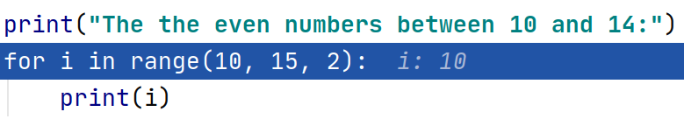
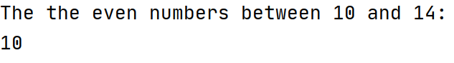
Notes:
[0:15; 16-17]

Slide 21
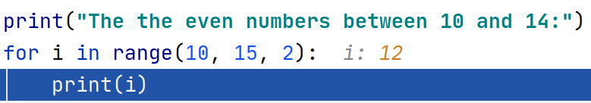
Notes:
[0:15; 16-17]

Slide 22

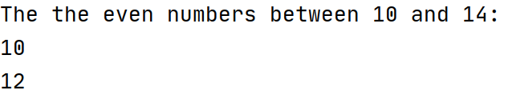
Notes:
[0:15; 16-17]

Slide 23

Notes:
[0:15; 17-18]

Slide 24

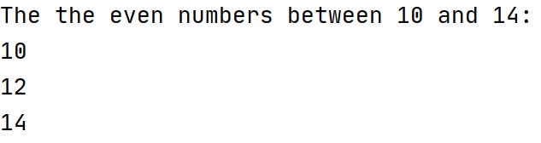
Notes:
[0:15; 17-18]

Slide 25
Notes:
[0:15; 18-19]

Slide 26
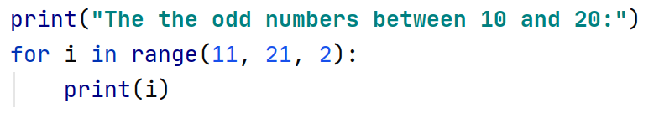
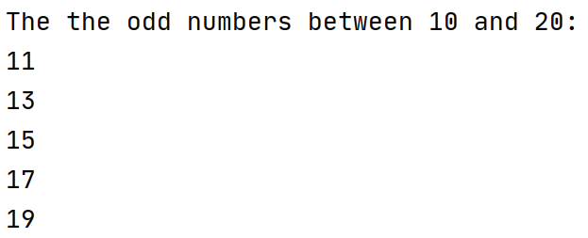
Notes:
[1:0; 19-20]

Slide 27
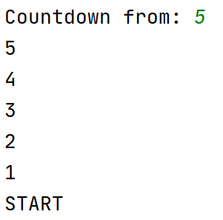
How to do this?
Notes:
[2:0; 20-22]
More complex program
think about it for 1 minute

Slide 28
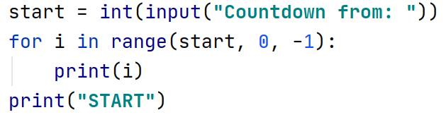
Notes:
[1:0; 22-23]

Slide 29
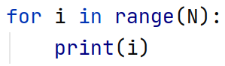
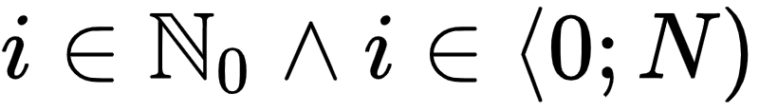
i = 0, 1, 2, …, N−1
Notes:
[1:0; 23-24]

Slide 30
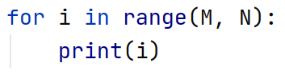
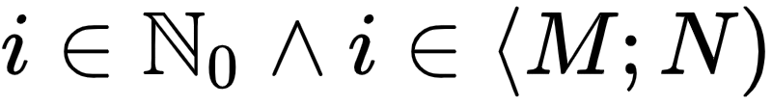
i = M, M+1, M+2, …, N−1
Notes:
[0:30; 24-25]

Slide 31
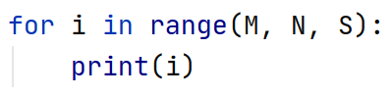
i = M, M+S, M+2S, M+3S, …
i < N
Notes:
[1:0; 25-26]

